Slide 1

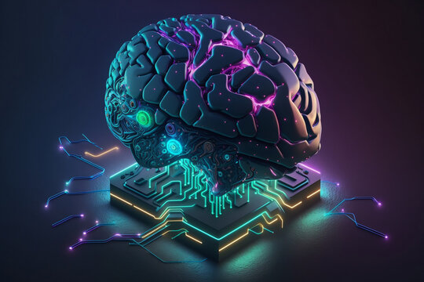
MRI Detection PABLO GARCIA THIBAULT POUX NABIL KACI

Slide 2
INDEX
Brief Explanation in what consists the Project
Data Processing
Models classifiers we chose
QUADRATIC
KNN
MLP
CNN
KNMEANS
Metrics
Roc Curve
Confusion Matrix
Final Explanation on our final pick

Slide 3

MRI-based brain tumor detection

Slide 4
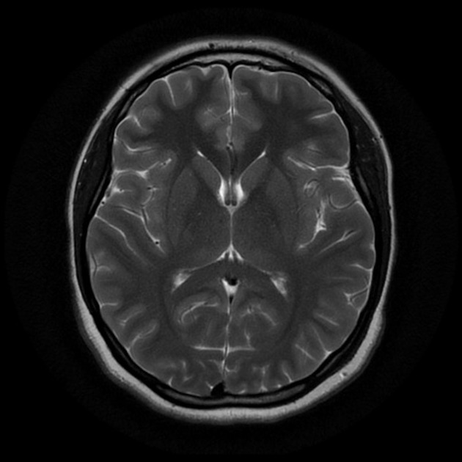
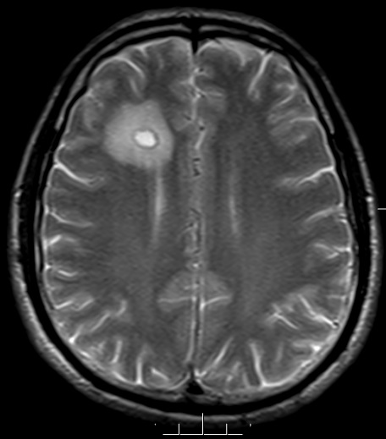
Our Project:
We're employing machine learning to detect brain tumors in magnetic resonance imaging (MRI) scans.
Our process involves data preprocessing and building several model
Our aim is to develop accurate models to aid in early diagnosis and effective treatment of brain tumors.
The general idea for each problem has been to test several classifiers and choose the best one’s according their accuracy and after those three we have carried out several tests to see which one is the best for each problem
DATA IMBALANCE:
Images with brain tumors: 155
Images with no brain tumors: 98

Slide 5
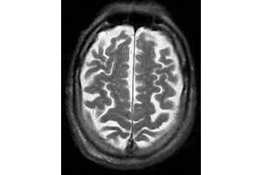
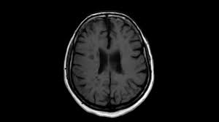
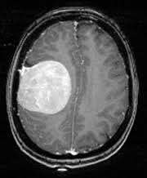
Data Processing
For our project, we chose a dataset from Kaggle. However, as you can see, most of the images have different shapes, sizes, and backgrounds.
Size 300*200
Size 300*168
Size 180*218

Slide 6


Data Processing
The first thing we tried was resizing the image, but it's clear that all the images are now distorted.

Slide 7
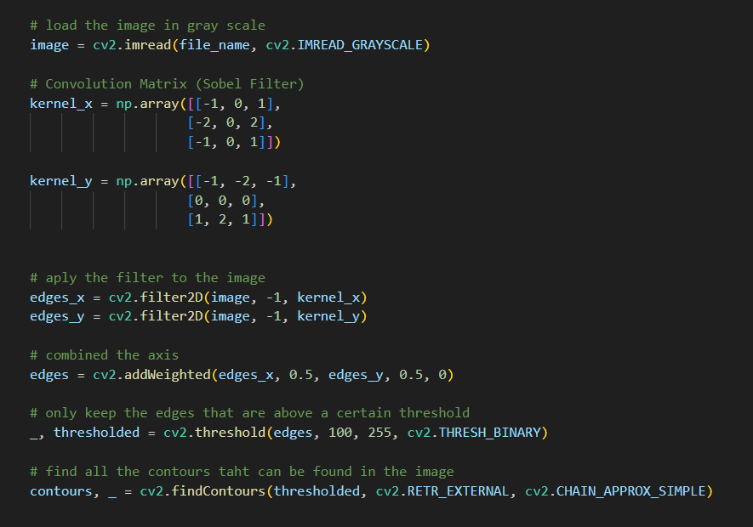
Data Processing
Our next approach was to use a Sobel filter to detect the outline of the brain and resize the image accordingly, aiming to remove all unnecessary background.

Slide 8
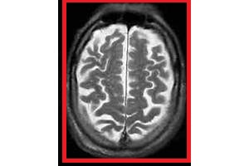
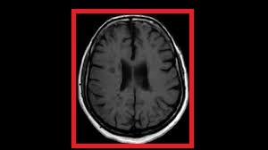
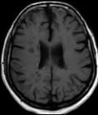
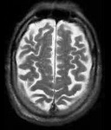
Data Processing
Our next approach was to use a Sobel filter to detect the outline of the brain and resize the image accordingly, aiming to remove all unnecessary background.

Slide 9
Models
QUADRATIC MODEL
A quadratic model is a mathematical representation that includes terms with variables raised to the second power. It describes a non-linear relationship between variables, often represented by a curve rather than a straight line.
KNN
KNN, or K-Nearest Neighbors, is a simple yet powerful algorithm used for classification and regression tasks. In KNN, when we want to make a prediction for a new data point, we look at the 'K' nearest data points to it (nearest neighbors) based on some similarity measure (usually Euclidean distance). Then, for classification, we assign the majority class among these neighbors to the new data point, and for regression, we take the average of the target values of these neighbors. It's like asking your friends who live closest to you to help you make a decision.
MLP
MLP, or Multi-Layer Perceptron, is a type of neural network with layers of interconnected nodes. It's used for tasks like classification and regression. Information flows through the network, and each layer applies transformations to the data. Training involves adjusting weights to minimize prediction errors.
KMEANS
K-means is a clustering algorithm that groups data points into K clusters based on their similarity. It works by iteratively updating cluster centroids until convergence. Simple and efficient, it's used for tasks like customer segmentation and image compression.

Slide 10

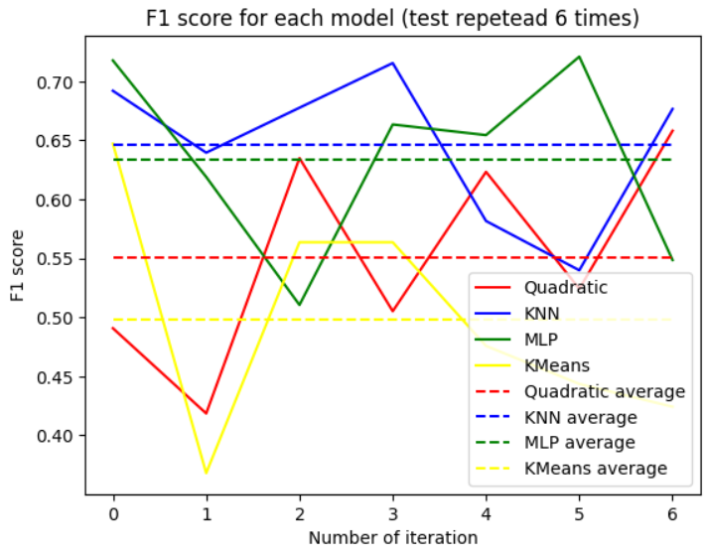
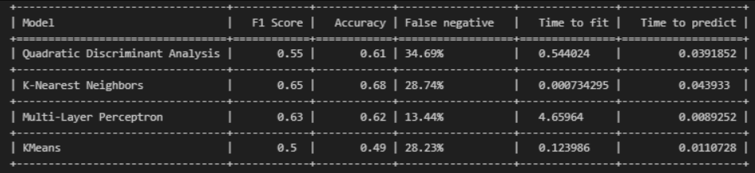
GENERAL OVERVIEW OF MODELS

Slide 11
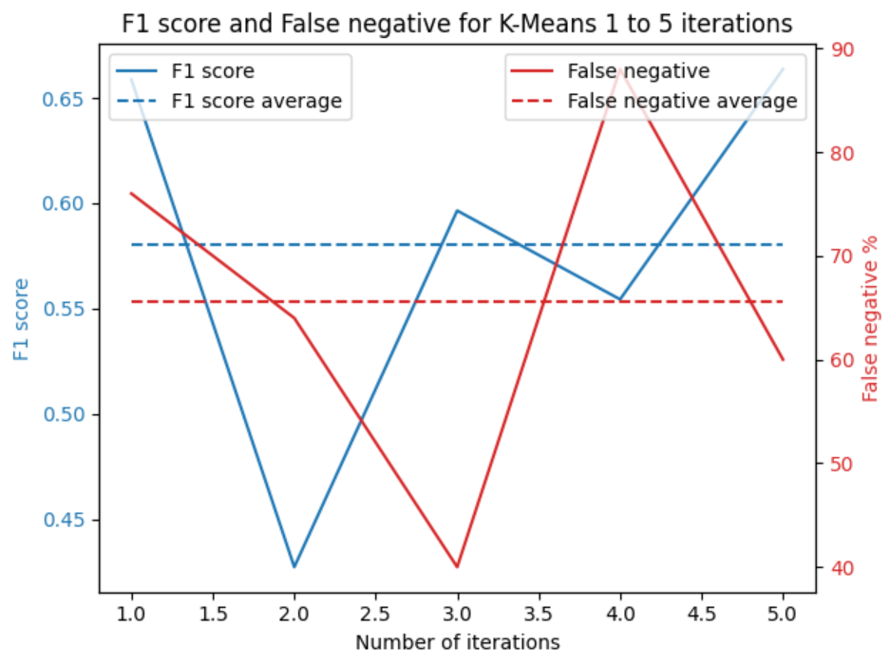
KMEANS

Slide 12
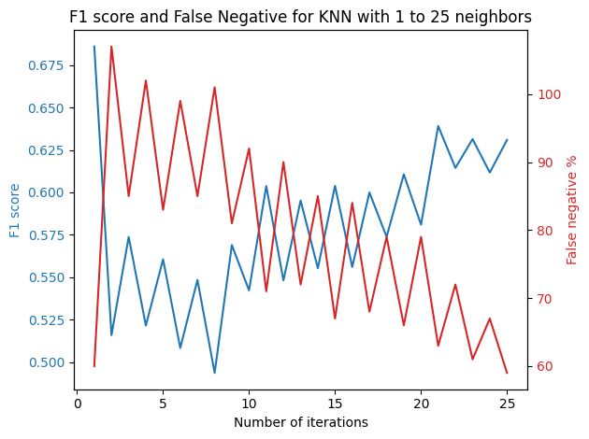
KNN

Slide 13
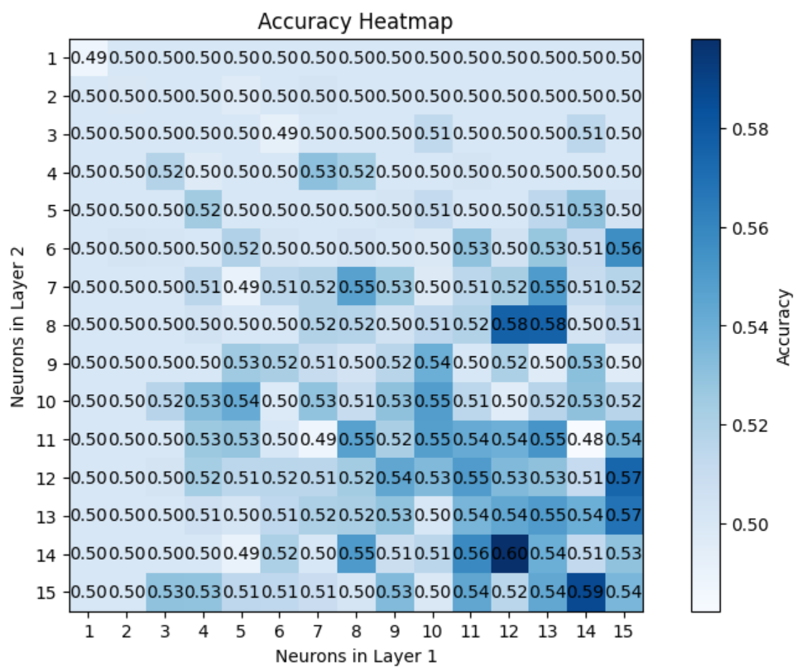
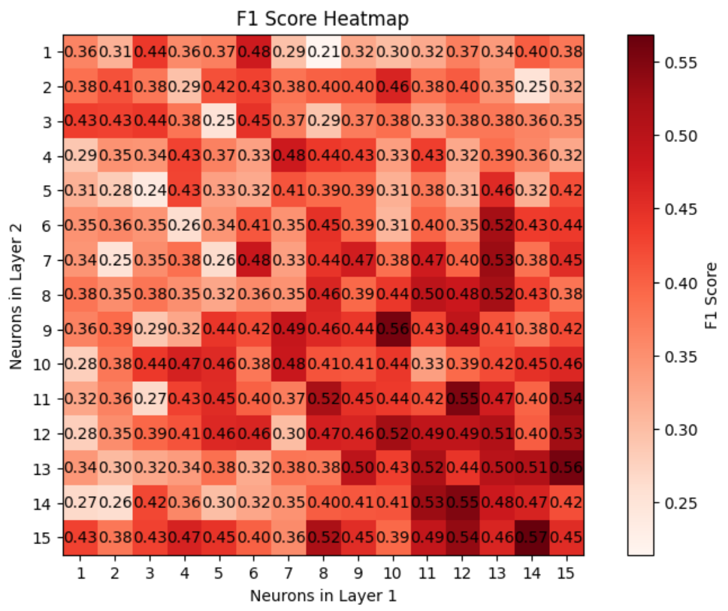
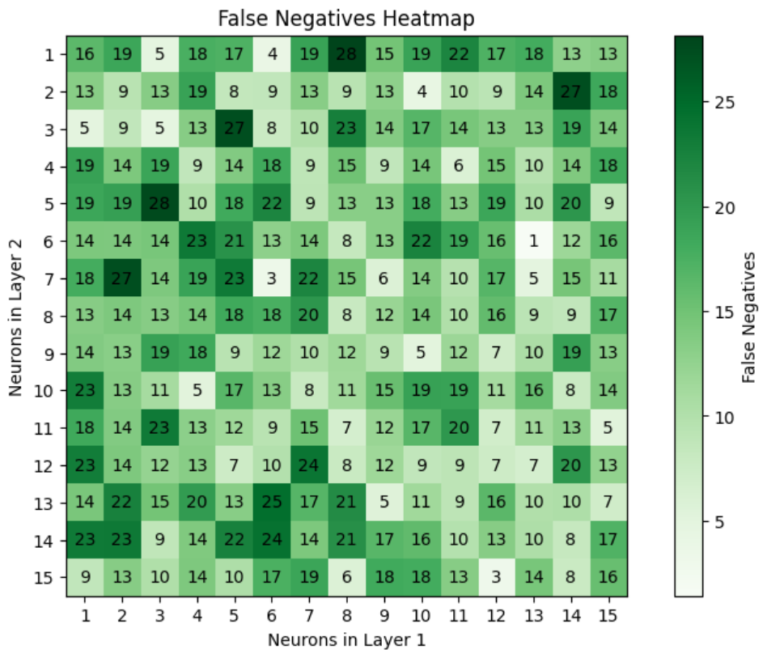
MLP

Slide 14
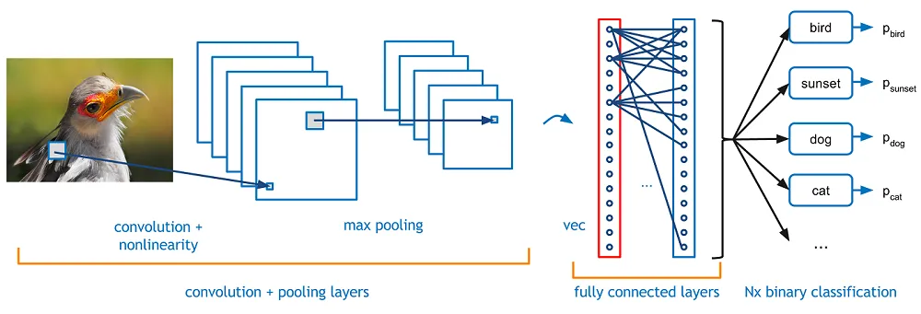
CNN

Slide 15
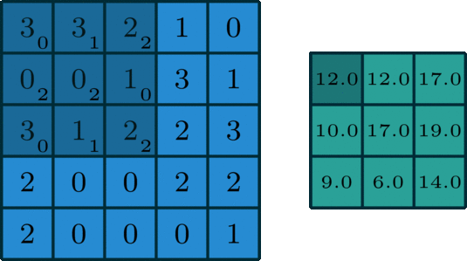
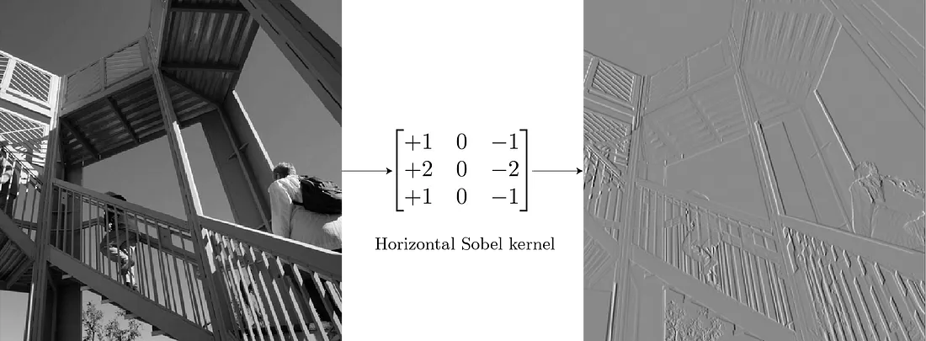
Convolution Layer

Slide 16

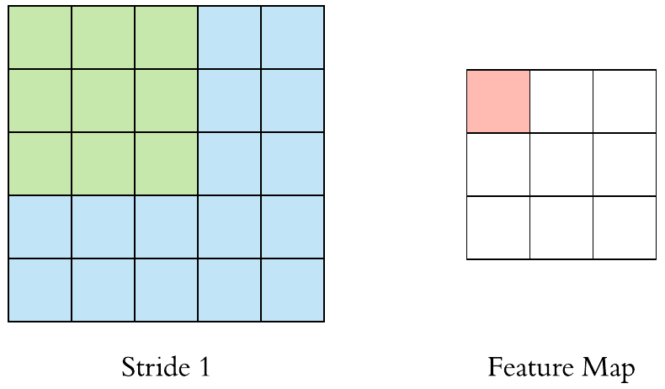
Convolution Layer
Padding method
Stradding method

Slide 17
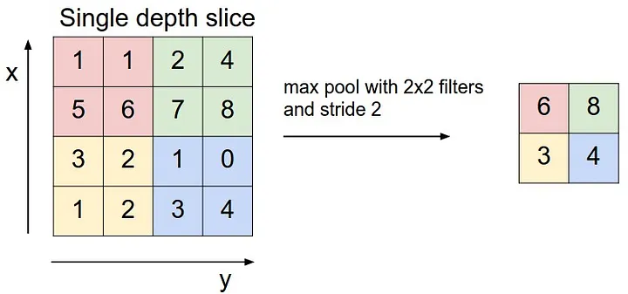
Pooling Layer

Slide 18
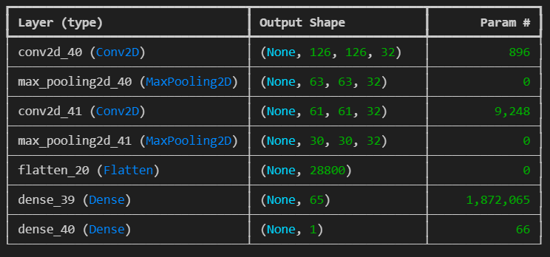
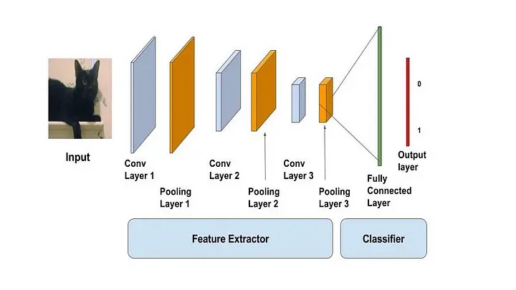
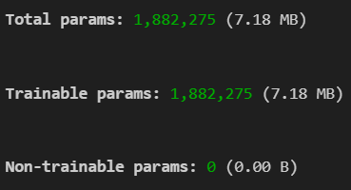
CNN

Slide 19
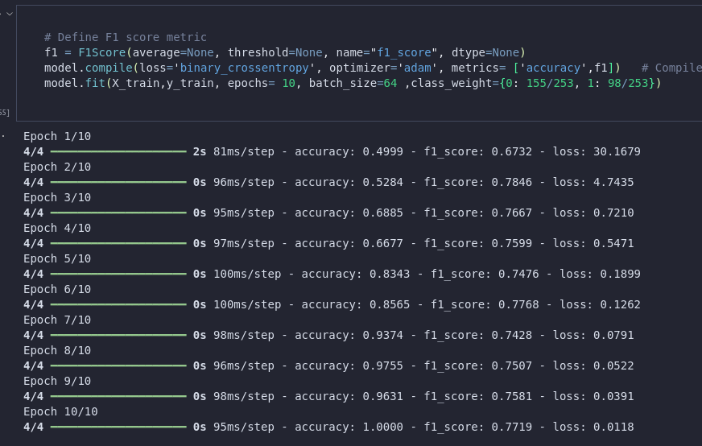
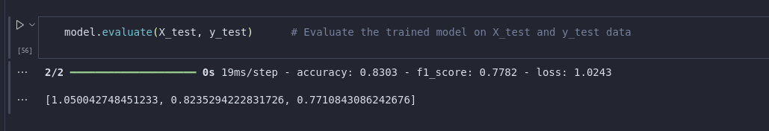
CNN

Slide 20
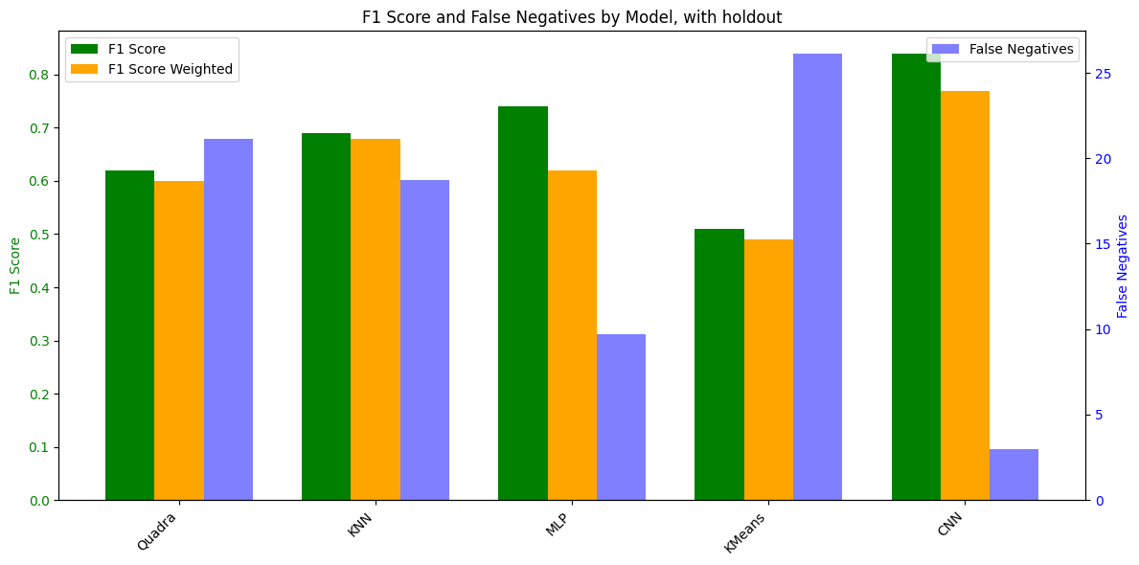
Conclusion

Slide 21
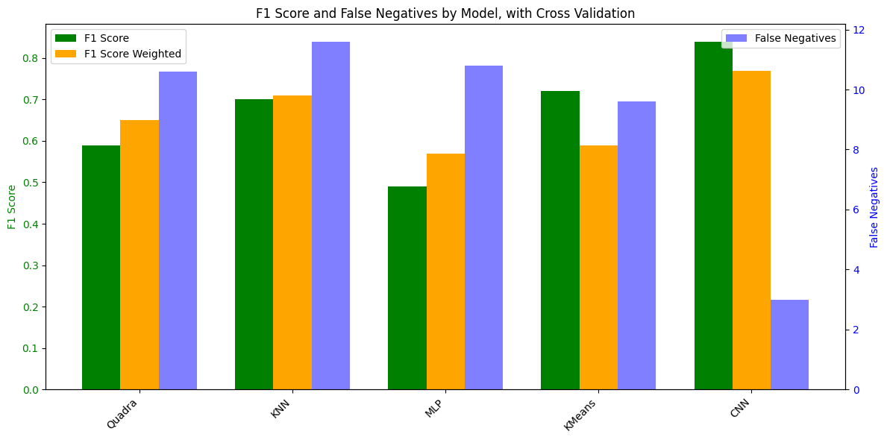
Conclusion

Slide 22
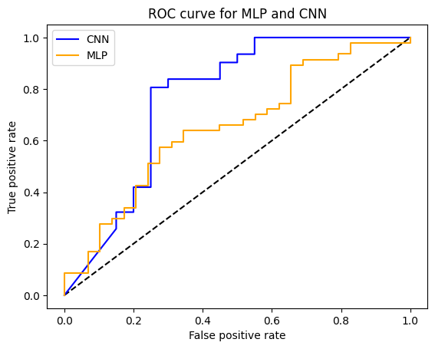
Conclusion

Slide 23

Thanks Any Questions?
PABLO GARCIA
THIBAULT POUX
NABIL KACI

